Slide 1

Internal Knowledge Sharing - 02
Raj Desai
03/29/2022

Slide 2
Generative Pre-trained Transformer 2(GPT 2): Understanding language generation through visualization

Slide 3
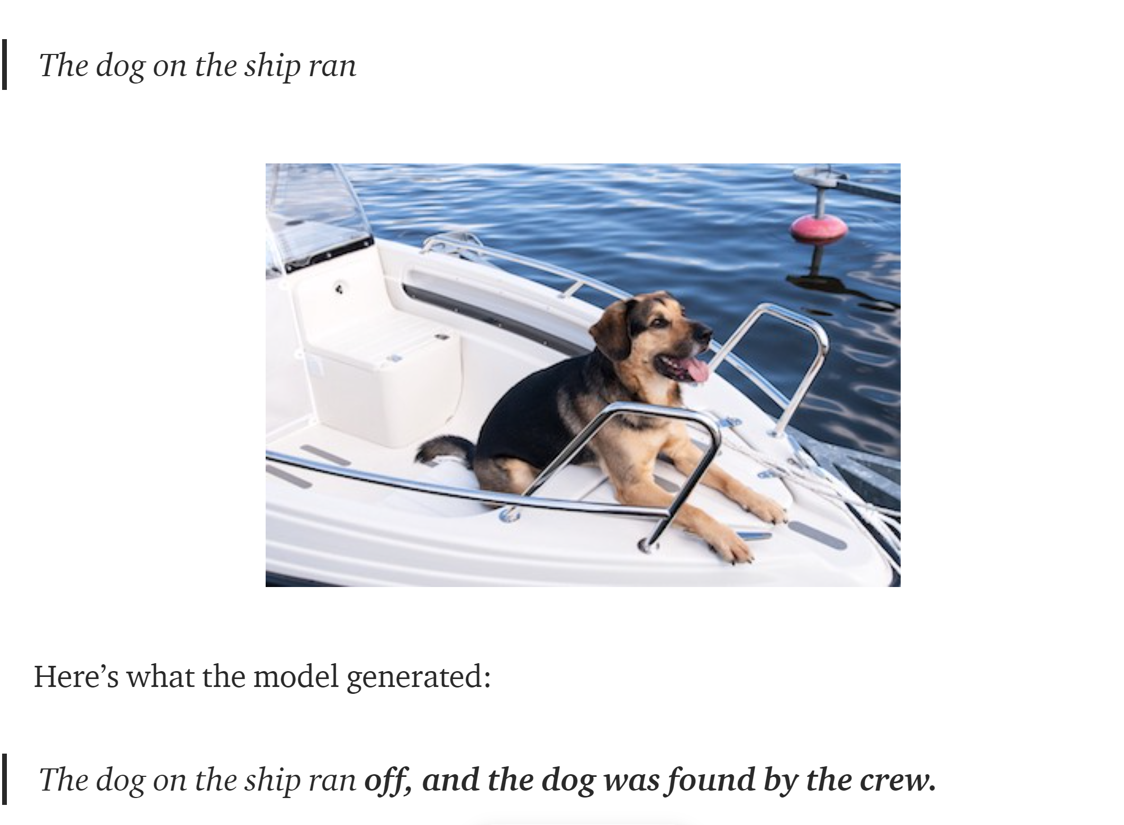
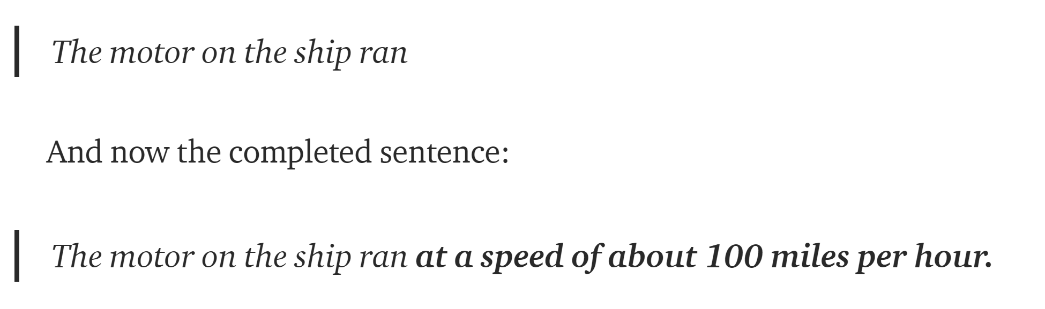
GPT -2
How is GPT-2 able to finish your thoughts?
How does GPT-2 know to pay such close attention to dog v/s motor?

Slide 4
GPT-2
The GPT-2 is based on Transformer which is an attention model — it learns to focus attention on the previous words that are the most relevant to the task at hand: predicting the next word in the sentence.
GPT-2 translates text, answers questions, summarizes passages, and generates text output on a level that, while sometimes indistinguishable from that of humans.
It can become repetitive or nonsensical when generating long passages.

Slide 5
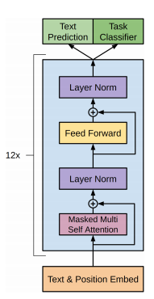
Gpt-2 Architecture
Input Representation : Text representations is a good way to represent a word in neural network is undoubtedly true.
GPT-2 chooses the middle one which is subword. Subword can be obtained by Byte Pair Encoding (BPE) algorithm.
GPT-2 leverages transformer model. While the difference between GPT and GPT-2 are:
Moving normalization layer to the input of each sub-block
Adding normalization layer after final self-attention model

Slide 6
Byte pair encoding
BPE is way of compression originally. A list of subword will be calculated by using the following algorithm.
Split word to sequence of characters.
Joining the highest frequency pattern
Keeping doing previous step until it hit the pre-defined maximum number of sub-word of iterations.

Slide 7
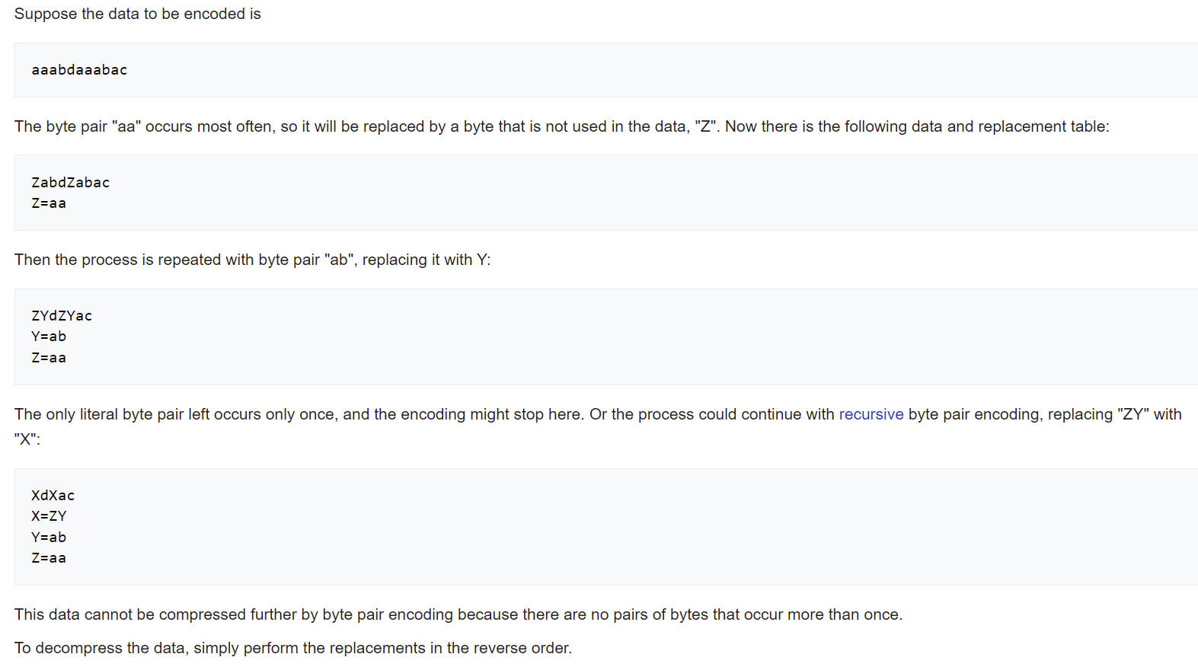
Byte pair encoding example

Slide 8
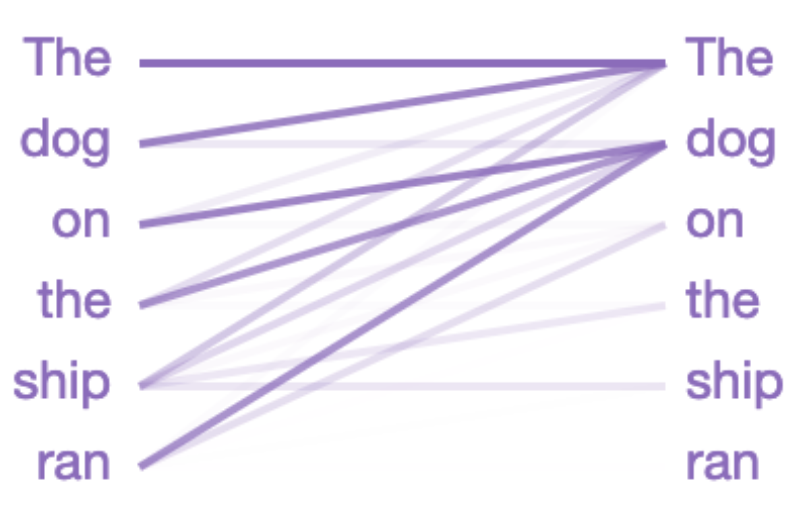
Illustration of Example
In linguistics terminology, the model is focusing on the head of the noun phrase the dog on the ship.
There are many other linguistic properties that GPT-2 captures as well, because the above attention pattern is just one of the 144 attention patterns in the model.
GPT-2 has 12 layers, each with 12 independent attention mechanisms, called “heads”; the result is 12 x 12 = 144 distinct attention patterns.

Slide 9
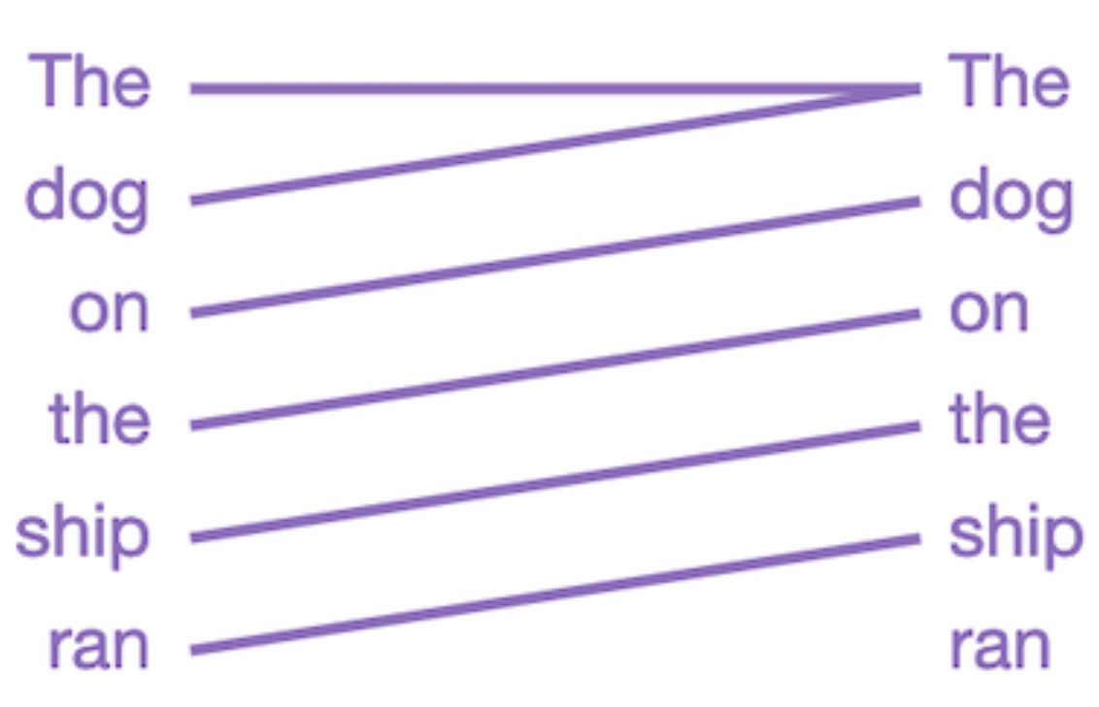
Illustration of Example
This layer/head focuses all attention on the previous word in the sentence.
This makes sense, because adjacent words are often the most relevant for predicting the next word. Traditional n-gram language models are based on this same intuition.

Slide 10
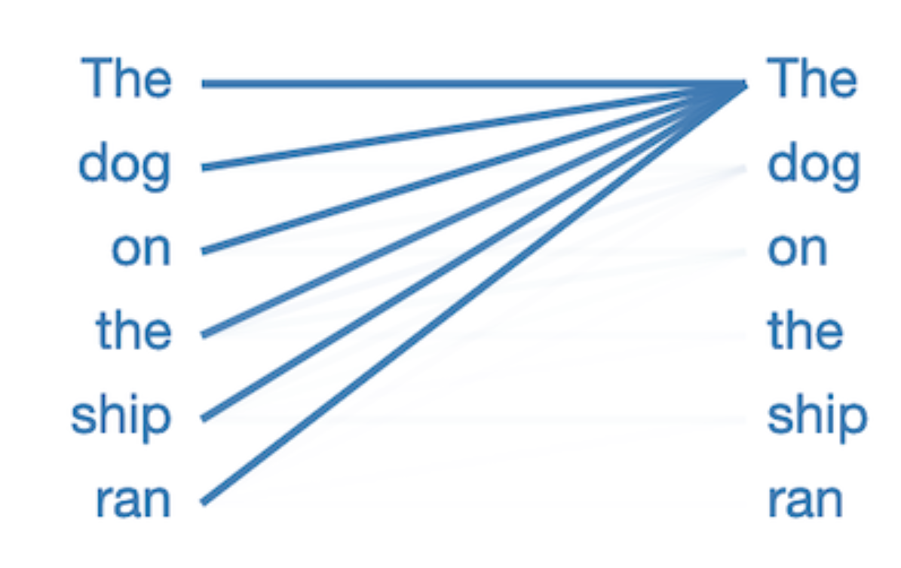
Illustration of Example
In this pattern, virtually all attention is focused on the first word in the sentence, and other words are ignored.
This appears to be the null pattern, indicating that the attention head hasn’t found whatever linguistic phenomenon it is looking for.

Slide 11
Advantages of GPT-2
It requires a very few examples of data to train the model.
There is no fine-tuning stage for GPT-2.
GPT-2 use unsupervised learning approach to train the language model.
No custom training for GPT-2.

Slide 12
Some Takeaways from using GPT-2
Using subword (BPE) instead of using character and word embeddings. Maybe word embeddings is too high level while pure character embeddings is too low level. BPE includes character level, subword level and word level embeddings.
Data is important but it is expensive to have labeled data.
GPT-2 is auto-regressive in nature: each token in the sentence has the context of the previous words. Thus GPT-2 works one token at a time. BERT, by contrast, is not auto-regressive. It uses the entire surrounding context all-at-once.
By trying the pre-trained model several times, there is impressive result.

Slide 13
References
https://towardsdatascience.com/openai-gpt-2-understanding-language-generation-through-visualization-8252f683b2f8
https://towardsdatascience.com/too-powerful-nlp-model-generative-pre-training-2-4cc6afb6655

